Slide 1
STOR 455
Class 38
Read: 8.1
Exercises: 8.3, 6

Slide 2
ANOVA for Difference in K Means
Data: Samples from K different groups
Summary statistics:
For each group
Combine all
Test: H_{o}: μ₁ = μ₂=...= μ_{K}
H_{a}: Some μ_{i} ≠μ_{j}

Slide 3
Checking Conditions for ANOVA
Check with residuals
Zero mean:
Always holds for sample residuals
Constant variance:
Plot residuals vs. fits and/or compare std. dev.’s of groups
(Check if some group s_{i} is more than twice another)
Normality:
Histogram/normal plot of residuals
Independence:
Pay attention to data collection

Slide 4
Example: Five Students
Barb Betsy Bill Bob Bud
Exam #1:
Exam #2:
Exam #3:
Exam #4:
62 94 68 86 50
87 95 93 97 63
74 86 82 70 28
77 89 73 79 47
Mean 75.0 91.0 79.0 83.0 47.0
Is there a significant difference in average grade among the five students?

Slide 5
ANOVA for Grades vs. Students
> tapply(Exams4$Grade,Exams4$Student,mean)
Barb Betsy Bill Bob Bud
75 91 79 83 47
> round(tapply(Exams4$Grade,Exams4$Student,sd),2)
Barb Betsy Bill Bob Bud
10.30 4.24 10.98 11.40 14.45
> modS=aov(Grade~Student,data=Exams4)
> summary(modS)
Df Sum Sq Mean Sq F value Pr(>F)
Student 4 4480 1120.0 9.6 0.000468 ***
Residuals 15 1750 116.7
Can we assume equal variances?

Slide 6
Levene’s Test for Equality of Variances
=
+
Conduct analysis of variance on the collection of absolute deviations.
Median of group k

Slide 7
Example: Five Students
Barb Betsy Bill Bob Bud
62 94 68 86 50
87 95 93 97 63
74 86 82 70 28
77 89 73 79 47
Median 75.5 91.5 77.5 82.5 48.5
> tapply(Exams4$Grade, Exams4$Student,median)
Barb Betsy Bill Bob Bud
75.5 91.5 77.5 82.5 48.5

Slide 8
Levene’s Test for Grades versus Students
medians=rep(tapply(Exams4$Grade, Exams4$Student,median),each=4)
Barb Barb Barb Barb Betsy Betsy Betsy Betsy Bill Bill Bill
75.5 75.5 75.5 75.5 91.5 91.5 91.5 91.5 77.5 77.5 77.5
Bill Bob Bob Bob Bob Bud Bud Bud Bud
77.5 82.5 82.5 82.5 82.5 48.5 48.5 48.5 48.5
LeveneData=abs(Exams4$Grade-medians)
LeveneData
Barb Barb Barb Barb Betsy Betsy Betsy Betsy Bill Bill
13.5 11.5 1.5 1.5 2.5 3.5 5.5 2.5 9.5 15.5
Bill Bill Bob Bob Bob Bob Bud Bud Bud Bud
4.5 4.5 3.5 14.5 12.5 3.5 1.5 14.5 20.5 1.5

Slide 9
Levene’s Test for Grades versus Students
Levene_aov = aov(LeveneData~Exams4$Student))
summary(Levene_aov)
Df Sum Sq Mean Sq F value Pr(>F)
Exams4$Student 4 88.8 22.20 0.567 0.69
Residuals 15 587.0 39.13
library(car)
leveneTest(Exams4$Grade, Exams4$Student)
Levene's Test for Homogeneity of Variance (center = median)
Df F value Pr(>F)
group 4 0.5673 0.6903
15

Slide 10
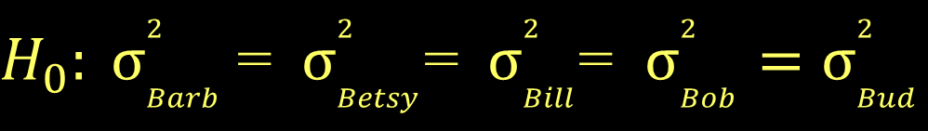
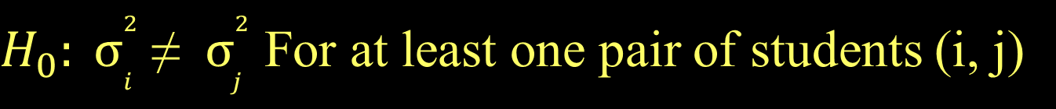
Levene’s Test for Grades versus Students
$H_{0}: σ_{Barb}^{2}$= $σ_{Betsy}^{2}$=$σ_{Bill}^{2}$= $σ_{Bob}^{2}=σ_{Bud}^{2}$
$H_{0}: σ_{i}^{2}$≠ $σ_{j}^{2}$ For at least one pair of students (i, j)
Levene's Test for Homogeneity of Variance (center = median)
Df F value Pr(>F)
group 4 0.5673 0.6903
15
There is not statistically significant evidence to suggest that students’ grades have difference variances.

Slide 11
Cancer Survival with Ascorbate Supplement
In the 1970’s doctors wondered if giving terminal cancer patients a supplement of ascorbate would prolong their lives. They designed an experiment to compare cancer patients who received ascorbate to cancer patients who did not receive the supplement. The result of that experiment was that, in fact, ascorbate did seem to prolong the lives of these patients. But then a second question arose. Was the effect of the ascorbate different when different organs were affected by the cancer? The researchers took a second look at the data. This time they concentrated only on those patients who received the ascorbate and divided the data up by which organ was affected by the cancer. They had 5 different organs represented among the patients (all of whom only had one organ affected): Stomach, bronchus, colon, ovary, and breast.
CancerSurvival in Stat2Data package

Slide 12
Cancer Survival with Ascorbate Supplement
library(Stat2Data)
data("CancerSurvival")
head(CancerSurvival)
Cancermod = aov(Survival~Organ, data=CancerSurvival)
summary(Cancermod)
Df Sum Sq Mean Sq F value Pr(>F)
Organ 4 11535761 2883940 6.433 0.000229 ***
Residuals 59 26448144 448274
Test: H_{o}: μ₁ = μ₂=...= μ_{K}
H_{a}: Some μ_{i} ≠μ_{j}
Reject H₀

Slide 13
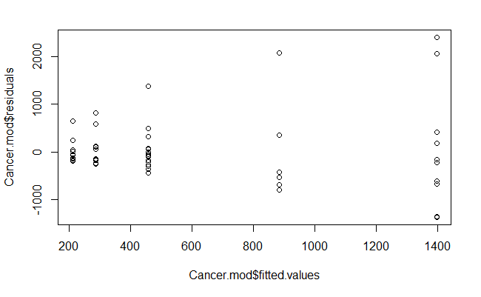
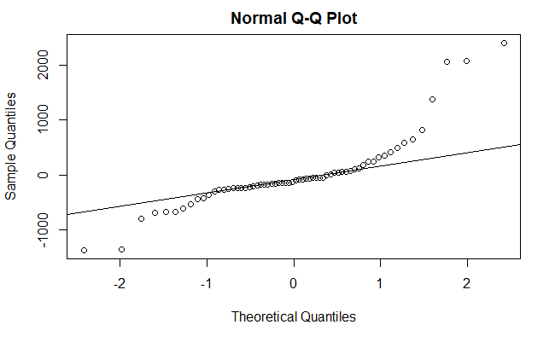
Cancer Survival with Ascorbate Supplement
plot(Cancermod$residuals~Cancermod$fitted.values)
qqnorm(Cancermod$residuals)
qqline(Cancermod$residuals)

Slide 14
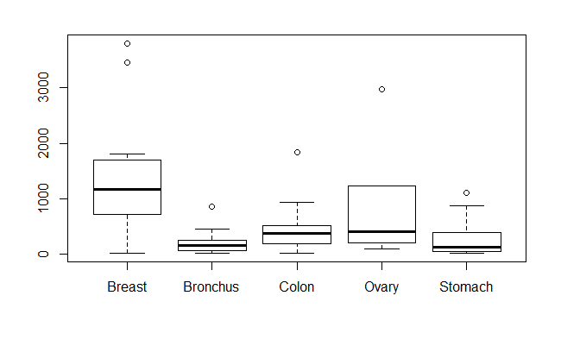
Cancer Survival with Ascorbate Supplement
boxplot(Survival~Organ, data=CancerSurvival)
tapply(CancerSurvival$Survival,CancerSurvival$Organ, sd)
Breast Bronchus Colon Ovary Stomach
1238.9667 209.8586 427.1686 1098.5788 346.3096

Slide 15
Cancer Survival with Ascorbate Supplement
leveneTest(CancerSurvival$Survival,CancerSurvival$Organ)
Levene's Test for Homogeneity of Variance (center = median)
Df F value Pr(>F)
group 4 4.4524 0.003271 **
59
Reject H₀
Would a transformation help?

Slide 16
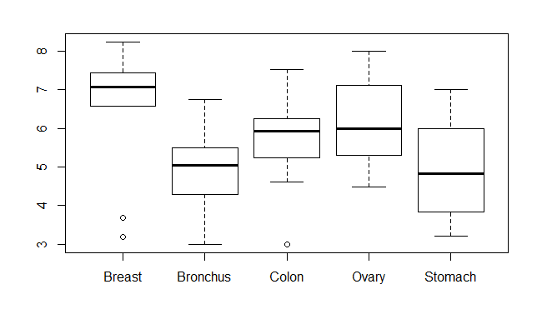
Cancer Survival with Ascorbate Supplement
boxplot(log(Survival)~Organ, data=CancerSurvival)
tapply(log(CancerSurvival$Survival),CancerSurvival$Organ, sd)
Breast Bronchus Colon Ovary Stomach
1.6477550 0.9534041 0.9974766 1.2569313 1.2502073

Slide 17
Cancer Survival with Ascorbate Supplement
leveneTest(log(CancerSurvival$Survival),CancerSurvival$Organ)
Levene's Test for Homogeneity of Variance (center = median)
Df F value Pr(>F)
group 4 0.6685 0.6164
59
Fail to Reject H₀

Slide 18
Cancer Survival with Ascorbate Supplement
Cancermod_log = aov(log(Survival)~Organ, data=CancerSurvival)
summary(Cancermod_log)
Df Sum Sq Mean Sq F value Pr(>F)
Organ 4 24.49 6.122 4.286 0.00412 **
Residuals 59 84.27 1.428
Test: H_{o}: μ₁ = μ₂=...= μ_{K}
H_{a}: Some μ_{i} ≠μ_{j}
Reject H₀

Slide 19
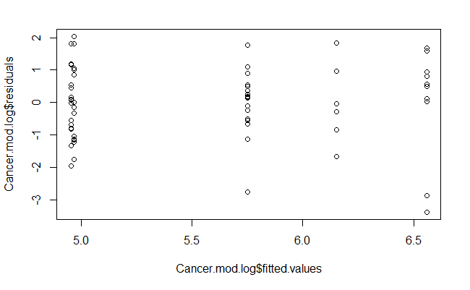
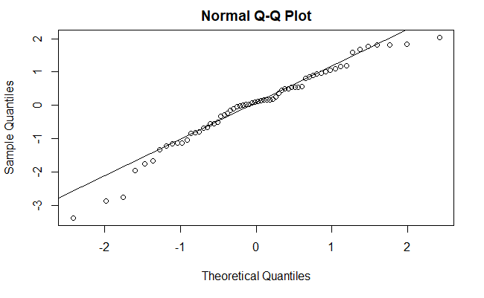
Cancer Survival with Ascorbate Supplement
plot(Cancermod_log$residuals~Cancermod_log$fitted.values)
qqnorm(Cancermod_log$residuals)
qqline(Cancermod_log$residuals)

Slide 20
Cancer Survival with Ascorbate Supplement
TukeyHSD(Cancermod_log)
Tukey multiple comparisons of means
95% family-wise confidence level
Fit: aov(formula = log(Survival) ~ Organ, data = CancerSurvival)
$`Organ`
diff lwr upr p adj
Bronchus-Breast -1.60543320 -2.906741 -0.3041254 0.0083352
Colon-Breast -0.80948110 -2.110789 0.4918267 0.4119156
Ovary-Breast -0.40798703 -2.114754 1.2987803 0.9615409
Stomach-Breast -1.59068365 -2.968399 -0.2129685 0.0158132
Colon-Bronchus 0.79595210 -0.357534 1.9494382 0.3072938
Ovary-Bronchus 1.19744617 -0.399483 2.7943753 0.2296079
Stomach-Bronchus 0.01474955 -1.224293 1.2537924 0.9999997
Ovary-Colon 0.40149407 -1.195435 1.9984232 0.9540004
Stomach-Colon -0.78120255 -2.020245 0.4578403 0.3981146
Stomach-Ovary -1.18269662 -2.842480 0.4770864 0.2763506

